Slide 1
Chosen Project and Data Set
The project selected by Group 3 was the “Lambda Architecture” project, which aims to process data in both batches and streams, using data from sensors.
The group decided to utilize temperature data from sensors.
The data was retrieved from a public dataset allocated at https://projects.knmi.nl/klimatologie/uurgegevens/selectie.cgi by selecting temperature data from all weather stations in the Netherlands from January 1st, 1951 to December 31st, 2019.
The dataset contains roughly 18 million measures, with the .txt file amounting to ~500MB.

Slide 2
Technology Stack and Motivation
Programming Language: Java 11, since 2 out of 3 have most experience with this PL
Framework: Apache Spark since it is a distributed cluster computing framework.
Message Queue: Apache Kafka Streams. RabbitMQ is an alternative, but Apache Kafka is optimized for distributed stream processing
Deployment Platform: Kubernetes for IaaS+, distribution, coordination and networking, resource management. 3 of us have experience with it.
Database: Apache Cassandra, since we will be working with sensor data as time series
Streams Monitoring (Optional): Prometheus since it can be used to gather a variety of metrics within our processing network. An alternative would be InfluxDB, but Prometheus is open source and free.
Visualization Dashboard (Optional): Grafana since it allows us to visualize the gathered metrics.

Slide 3
Processing flow Analysis Operations
The processing flow for operations will be modeled using a DAG or Directed Acyclic Graph. This way we can easily specify dependencies between operations. The DAG *might* also include parallelization as part of the structure. The DAG will be used to automatically schedule the required operations and synchronization in an efficient manner on the cluster.

Slide 4
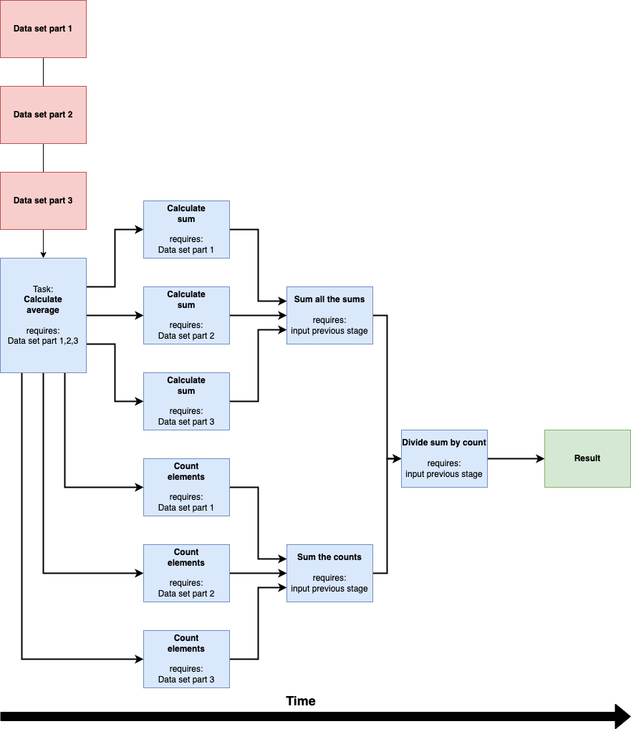
Possible examples of processing algorithms:
- Calculate simply moving average
- Calculate smoothing mean
- Generate DAGs for batch processing jobs.
- DAGs are used to schedule (potentially parallelized) jobs on the compute units.

Slide 5
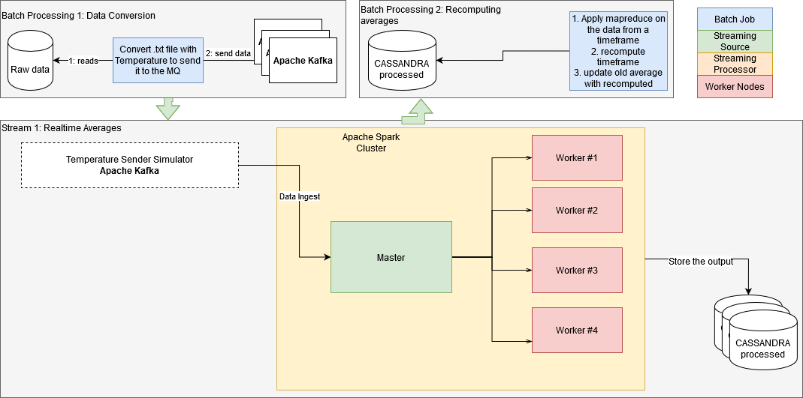
High-level Architecture and Components

Slide 6
High-Level Architecture and Components Elaboration
Batch Processing 1: The raw data (a file) is being read as a batch process and temporarily stored in Cassandra as unprocessed data: unprocessed_data[station, date, temperature].
Stream 1: A simulator reads the data and posts it to the SOURCE of the stream. This simulates the real life, in which weather stations post the data to external servers for processing. A filter is added to remove elements with invalid or null values. Afterwards, the values are forwarded to 4 sinks. 3 to keep track of the Moving Averages, and 1 to store the measurement in the DB. If this measurement is the last value of a day/month/year, a job is created to re-compute the average using batch processing.
Batch Processing 2: Multiple batch processors claim a job and recompute the mean for this job. Finally, the accurate mean is updated and stored in Cassandra.

